Slide 1
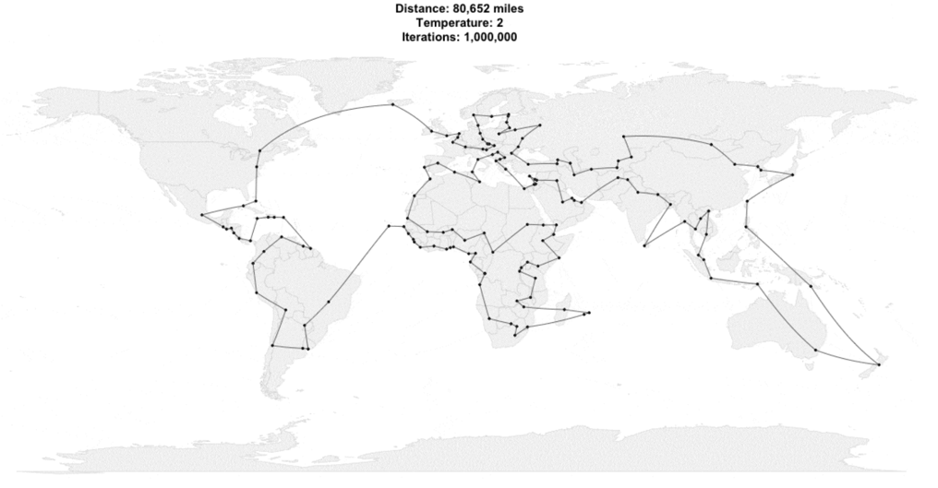
Asymptotics 2
Lecture 15
CS61B, Spring 2024 @ UC Berkeley
Slides Credit: Josh Hug
Notes:
Some modifications were made for SP24. If you'd like to follow along with Josh Hug's videos, you can reference the SP23 slides: https://docs.google.com/presentation/d/1BFJ7ycE15A83n6qKcZUUExezu2DC5DwHFpEKP4QOTyA

Slide 2
Intuitive Definitions of Functions
If my function f(n) is… | Doubling N | Adding 1 to N
Θ(1) | Doesn't affect runtime
Θ(log n) (base independent) | Adds 1 to runtime | Affects runtime minimally
Θ(n) | Doubles runtime | Adds 1 to runtime
Θ(n²) | Quadruples runtime | Adds n to runtime
Θ(2^{n}) (base dependent) | Squares runtime | Doubles runtime
Notes:
"Log" can also be thought of as "the number of digits in a number"

Slide 3
Nested For Loops
Nested For Loops
There is No Magic Shortcut for Asymptotic Analysis
Amortized Analysis
Recursive Analysis
Binary Search (Intuitive)
Binary Search (Exact) (Bonus Video)
Mergesort
Lecture 15, CS61B, Spring 2024

Slide 4
Loops Example 1: Based on Exact Count
Find the order of growth of the worst case runtime of dup1.
N = 6
int N = A.length;
for (int i = 0; i < N; i += 1)
for (int j = i + 1; j < N; j += 1)
if (A[i] == A[j])
return true;
return false;
0
1
2
3
4
5
 | == | == | == | == | ==
 |  | == | == | == | ==
 |  |  | == | == | ==
 |  |  |  | == | ==
 |  |  |  |  | ==
i
Worst case number of operations:
C = 1 + 2 + 3 + … + (N - 3) + (N - 2) + (N - 1) = N(N-1)/2
0 1 2 3 4 5
j
operation | worst case count
== | Θ(N²)
Worst case runtime: Θ(N²)
Overall worst case runtime: Θ(N²)

Slide 5
Loops Example 1: Based on Exact Count
Find the order of growth of the worst case runtime of dup1.
N = 6
int N = A.length;
for (int i = 0; i < N; i += 1)
for (int j = i + 1; j < N; j += 1)
// 1 unit of work
return false;
0
1
2
3
4
5
 | 1 | 1 | 1 | 1 | 1
 |  | 1 | 1 | 1 | 1
 |  |  | 1 | 1 | 1
 |  |  |  | 1 | 1
 |  |  |  |  | 1
i
Worst case number of operations:
C = 1 + 2 + 3 + … + (N - 3) + (N - 2) + (N - 1) = N(N-1)/2
0 1 2 3 4 5
j
operation | worst case count
Total | Θ(N²)
Worst case runtime: Θ(N²)
Overall worst case runtime: Θ(N²)

Slide 6
Loops Example 1: Based on Exact Count
Find the order of growth of the worst case runtime of dup1.
N = 6
int N = A.length;
for (int i = 0; i < N; i += 1)
// N-i-1 units of work
return false;
0
1
2
3
4
5
 | 5
 |  | 4
 |  |  | 3
 |  |  |  | 2
 |  |  |  |  | 1
i
Worst case number of operations:
C = 1 + 2 + 3 + … + (N - 3) + (N - 2) + (N - 1) = N(N-1)/2
0 1 2 3 4 5
j
operation | worst case count
Total | Θ(N²)
Worst case runtime: Θ(N²)
Overall worst case runtime: Θ(N²)

Slide 7
Loops Example 1: Based on Exact Count
Find the order of growth of the worst case runtime of dup1.
N = 6
int N = A.length;
for (int i = 0; i < N; i += 1)
// N-i-1 units of work
return false;
0
1
2
3
4
5
 | 5
 |  | 4
 |  |  | 3
 |  |  |  | 2
 |  |  |  |  | 1
i
Worst case number of operations:
Given by area of right triangle of side length N-1.
Area is Θ(N²).
Worst case number of operations:
0 1 2 3 4 5
j
operation | worst case count
Total | Θ(N²)
Worst case runtime: Θ(N²)
Overall worst case runtime: Θ(N²)

Slide 8
Loops Example 2 [attempt #1]: http://yellkey.com/personal
Find a simple f(N) such that the runtime R(N) ∈ Θ(f(N)). By simple, we mean there should be no unnecessary multiplicative constants or additive terms.
1
log N
N
public static void printParty(int N) {
for (int i = 1; i <= N; i = i * 2) {
for (int j = 0; j < i; j += 1) {
System.out.println("hello");
int ZUG = 1 + 1;
}
}
}
D. N log N
E. N²
F. Other
Note that there’s only one case for this code and thus there’s no distinction between “worst case” and otherwise.
Notes:
est: 11 minutes to get here

Slide 9
Loops Example 2: Prelude to Attempt #2
0
1
2
3
4
5
public static void printParty(int N) {
for (int i = 1; i <= N; i = i * 2) {
for (int j = 0; j < i; j += 1) {
//1 unit of work
} } }
i
Find a simple f(N) such that the runtime R(N) ∈ Θ(f(N)).
0 1 2 3 4 5
j
Cost model C(N):
N
1 | 2 | 3 | 4 | 5 | 6 | 7 | 8 | 9 | 10 | 11 | 12 | 13 | 14 | 15 | 16 | 17 | 18
C(N)
? | ? | ? | ? | ? | ? | ? | ? | ? | ? | ? | ? | ? | ? | ? | ? | ? | ?
Notes:
2m30s, 23 total

Slide 10
Loops Example 2: Prelude to Attempt #2
0
1
2
3
4
5
public static void printParty(int N) {
for (int i = 1; i <= N; i = i * 2) {
//i units of work
}
}
i
Find a simple f(N) such that the runtime R(N) ∈ Θ(f(N)).
0 1 2 3 4 5
Work
Cost model C(N):
N
1 | 2 | 3 | 4 | 5 | 6 | 7 | 8 | 9 | 10 | 11 | 12 | 13 | 14 | 15 | 16 | 17 | 18
C(N)
? | ? | ? | ? | ? | ? | ? | ? | ? | ? | ? | ? | ? | ? | ? | ? | ? | ?
Notes:
2m30s, 23 total

Slide 11
Loops Example 2: Prelude to Attempt #2
0
1
2
3
4
5
1
public static void printParty(int N) {
for (int i = 1; i <= N; i = i * 2) {
//i units of work
}
}
i
Find a simple f(N) such that the runtime R(N) ∈ Θ(f(N)).
0 1 2 3 4 5
Work
Cost model C(N):
N
1 | 2 | 3 | 4 | 5 | 6 | 7 | 8 | 9 | 10 | 11 | 12 | 13 | 14 | 15 | 16 | 17 | 18
C(N)
1
Notes:
2m30s, 23 total

Slide 12
Loops Example 2: Prelude to Attempt #2
0
1
2
3
4
5
1
2
public static void printParty(int N) {
for (int i = 1; i <= N; i = i * 2) {
//i units of work
}
}
i
Find a simple f(N) such that the runtime R(N) ∈ Θ(f(N)).
0 1 2 3 4 5
Work
Cost model C(N):
N
1 | 2 | 3 | 4 | 5 | 6 | 7 | 8 | 9 | 10 | 11 | 12 | 13 | 14 | 15 | 16 | 17 | 18
C(N)
1 | 3
Notes:
2m30s, 23 total

Slide 13
Loops Example 2: Prelude to Attempt #2
0
1
2
3
4
5
1
2
public static void printParty(int N) {
for (int i = 1; i <= N; i = i * 2) {
//i units of work
}
}
i
Find a simple f(N) such that the runtime R(N) ∈ Θ(f(N)).
0 1 2 3 4 5
Work
Cost model C(N):
N
1 | 2 | 3 | 4 | 5 | 6 | 7 | 8 | 9 | 10 | 11 | 12 | 13 | 14 | 15 | 16 | 17 | 18
C(N)
1 | 3 | 3
N=3 doesn't do anything extra
Notes:
2m30s, 23 total

Slide 14
Loops Example 2: Prelude to Attempt #2
0
1
2
3
4
5
1
2
4
public static void printParty(int N) {
for (int i = 1; i <= N; i = i * 2) {
//i units of work
}
}
i
Find a simple f(N) such that the runtime R(N) ∈ Θ(f(N)).
0 1 2 3 4 5
Work
Cost model C(N):
N
1 | 2 | 3 | 4 | 5 | 6 | 7 | 8 | 9 | 10 | 11 | 12 | 13 | 14 | 15 | 16 | 17 | 18
C(N)
1 | 3 | 3 | 7
Notes:
2m30s, 23 total

Slide 15
Loops Example 2: Prelude to Attempt #2
0
1
2
3
4
5
1
2
4
public static void printParty(int N) {
for (int i = 1; i <= N; i = i * 2) {
//i units of work
}
}
i
Find a simple f(N) such that the runtime R(N) ∈ Θ(f(N)).
0 1 2 3 4 5
Work
Cost model C(N):
N
1 | 2 | 3 | 4 | 5 | 6 | 7 | 8 | 9 | 10 | 11 | 12 | 13 | 14 | 15 | 16 | 17 | 18
C(N)
1 | 3 | 3 | 7 | 7 | 7 | 7
N=4,5,6,7 all print 7 times
Notes:
2m30s, 23 total

Slide 16
Loops Example 2: Prelude to Attempt #2
0
1
2
3
4
5
1
2
4
public static void printParty(int N) {
for (int i = 1; i <= N; i = i * 2) {
//i units of work
}
}
i
Find a simple f(N) such that the runtime R(N) ∈ Θ(f(N)).
0 1 2 3 4 5
Work
Cost model C(N):
N
1 | 2 | 3 | 4 | 5 | 6 | 7 | 8 | 9 | 10 | 11 | 12 | 13 | 14 | 15 | 16 | 17 | 18
C(N)
1 | 3 | 3 | 7 | 7 | 7 | 7
N=4,5,6,7 all print 7 times
Notes:
2m30s, 23 total

Slide 17
Loops Example 2: Prelude to Attempt #2
0
1
2
3
4
5
1
2
4
public static void printParty(int N) {
for (int i = 1; i <= N; i = i * 2) {
//i units of work
}
}
i
Find a simple f(N) such that the runtime R(N) ∈ Θ(f(N)).
0 1 2 3 4 5
Work
Cost model C(N):
N
1 | 2 | 3 | 4 | 5 | 6 | 7 | 8 | 9 | 10 | 11 | 12 | 13 | 14 | 15 | 16 | 17 | 18
C(N)
1 | 3 | 3 | 7 | 7 | 7 | 7 | 15 | 15 | 15 | 15 | 15 | 15 | 15 | 15
These N all print 15 times
Notes:
2m30s, 23 total

Slide 18
Loops Example 2: Prelude to Attempt #2
0
1
2
3
4
5
1
2
4
public static void printParty(int N) {
for (int i = 1; i <= N; i = i * 2) {
//i units of work
}
}
i
Find a simple f(N) such that the runtime R(N) ∈ Θ(f(N)).
0 1 2 3 4 5
Work
Cost model C(N):
N
1 | 2 | 3 | 4 | 5 | 6 | 7 | 8 | 9 | 10 | 11 | 12 | 13 | 14 | 15 | 16 | 17 | 18
C(N)
1 | 3 | 3 | 7 | 7 | 7 | 7 | 15 | 15 | 15 | 15 | 15 | 15 | 15 | 15 | 31 | 31 | 31
C(N) = 1 + 2 + 4 + … + N, if N is a power of 2
Notes:
2m30s, 23 total

Slide 19
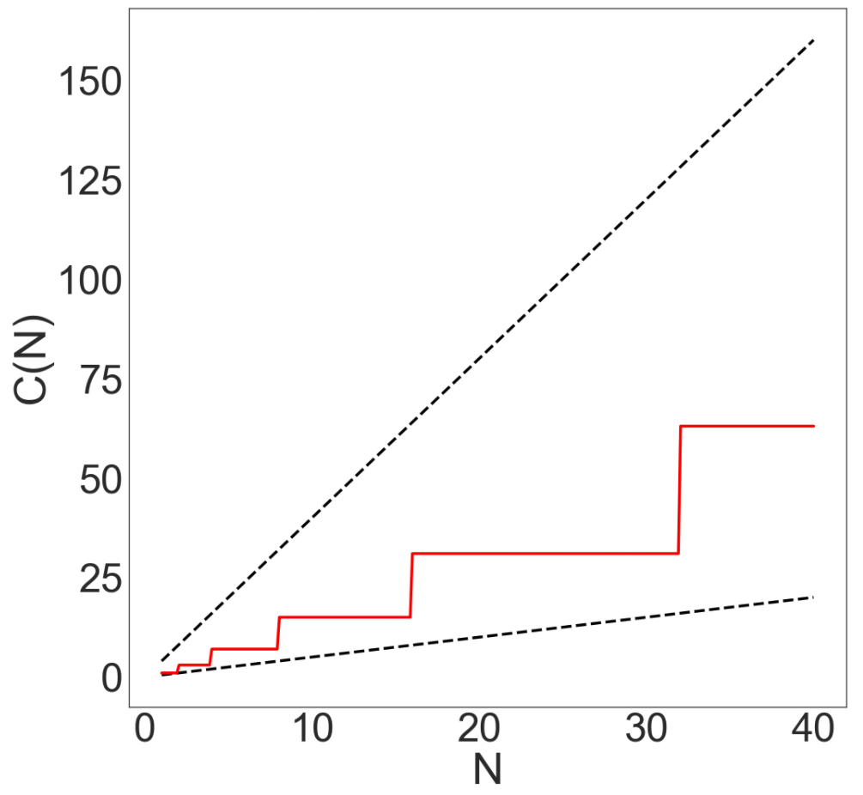
Loops Example 2: Prelude to Attempt #2
We’re trying to find the order of growth of C(N):
Cost model C(N):
N
1 | 2 | 3 | 4 | 5 | 6 | 7 | 8 | 9 | 10 | 11 | 12 | 13 | 14 | 15 | 16 | 17 | 18
C(N)
1 | 3 | 3 | 7 | 7 | 7 | 7 | 15 | 15 | 15 | 15 | 15 | 15 | 15 | 15 | 31 | 31 | 31
C(N) = 1 + 2 + 4 + … + N, if N is a power of 2
Notes:
2m30s, 23 total

Slide 20
Loops Example 2 [attempt #2]: http://yellkey.com/cup
Find a simple f(N) such that the runtime R(N) ∈ Θ(f(N)).
1
log N
N
D. N log N
E. N²
F. Other
public static void printParty(int N) {
for (int i = 1; i<=N; i = i * 2) {
for (int j = 0; j < i; j += 1) {
System.out.println("hello");
int ZUG = 1 + 1;
Cost model C(N):
N
1 | 2 | 3 | 4 | 5 | 6 | 7 | 8 | 9 | 10 | 11 | 12 | 13 | 14 | 15 | 16 | 17 | 18
C(N)
1 | 3 | 3 | 7 | 7 | 7 | 7 | 15 | 15 | 15 | 15 | 15 | 15 | 15 | 15 | 31 | 31 | 31
C(N) = 1 + 2 + 4 + … + N, if N is a power of 2
Notes:
2m30s, 23 total

Slide 21
Loops Example 2: Prelude to Attempt #3
Find a simple f(N) such that the runtime R(N) ∈ Θ(f(N)).
N | C(N) | 0.5 N | 2N
1 | 1 | 0.5 | 2
4 | 1 + 2 + 4 = 7 | 2 | 8
7 | 1 + 2 + 4 = 7 | 3.5 | 14
8 | 1 + 2 + 4 + 8 = 15 | 4 | 16
27 | 1 + 2 + 4 + 8 + 16 = 31 | 13.5 | 54
185 | … + 64 + 128 = 255 | 92.5 | 370
715 | … + 256 + 512 = 1023 | 357.5 | 1430
Notes:
2m30s, 23 total

Slide 22
Loops Example 2 [attempt #3] (no yellkey)
Find a simple f(N) such that the runtime R(N) ∈ Θ(f(N)).
N | C(N)
1 | 1
4 | 1 + 2 + 4 = 7
7 | 1 + 2 + 4 = 7
8 | 1 + 2 + 4 + 8 = 15
27 | 1 + 2 + 4 + 8 + 16 = 31
185 | … + 64 + 128 = 255
715 | … + 256 + 512 = 1023
N | C(N) | 0.5 N | 2N
1 | 1 | 0.5 | 2
4 | 7 | 2 | 8
7 | 7 | 3.5 | 14
8 | 15 | 4 | 16
27 | 31 | 13.5 | 54
185 | 255 | 92.5 | 370
715 | 1023 | 357.5 | 1430
public static void printParty(int n) {
for (int i = 1; i<=n; i = i * 2) {
for (int j = 0; j < i; j += 1) {
System.out.println("hello");
int ZUG = 1 + 1;
Cost model C(N), println(“hello”) calls:
R(N) = Θ(1 + 2 + 4 + 8 + … + N) if N is power of 2.
1
log N
N
D. N log N
E. N²
F. Something else
Notes:
2m30s, 23 total

Slide 23
Loops Example 2 [attempt #3] (no yellkey)
Find a simple f(N) such that the runtime R(N) ∈ Θ(f(N)).
R(N) = Θ(1 + 2 + 4 + 8 + … + N)
= Θ(N)
1
log N
N
D. N log N
E. N²
F. Something else
Notes:
2m30s, 23 total

Slide 24
Loops Example 2 [attempt #3] (no yellkey)
Can also compute exactly:
1
2
4
8
16
Notes:
2m30s, 23 total

Slide 25
Loops Example 2 [attempt #3] (no yellkey)
Can also compute exactly:
2 |  | 1
4
8
16
Notes:
2m30s, 23 total

Slide 26
Loops Example 2 [attempt #3] (no yellkey)
Can also compute exactly:
4 |  |  |  | 2 |  | 1
8
16
Notes:
2m30s, 23 total

Slide 27
Loops Example 2 [attempt #3] (no yellkey)
Can also compute exactly:
1 + 2 + 4 + … + 2^{k} = 2(2^{k}) - 1
If N = 2^{k}:
1 + 2 + 4 + … + N = 2N - 1
R(N) = Θ(1 + 2 + 4 + 8 + … + N)
= Θ(N)
1
log N
N
D. N log N
E. N²
F. Something else
8 |  |  |  |  |  |  |  | 4 |  |  |  | 2 |  | 1
16
Notes:
2m30s, 23 total

Slide 28
There is No Magic Shortcut for Asymptotic Analysis
Nested For Loops
There is No Magic Shortcut for Asymptotic Analysis
Amortized Analysis
Recursive Analysis
Binary Search (Intuitive)
Binary Search (Exact) (Bonus Video)
Mergesort
Lecture 15, CS61B, Spring 2024

Slide 29
Repeat After Me...
There is no magic shortcut for asymptotic analysis problems
Runtime analysis often requires careful thought.
CS70 and especially CS170 will cover this in much more detail.
This is not a math class, though we’ll expect you to know these:
1 + 2 + 3 + … + Q = Q(Q+1)/2 = Θ(Q²)
1^{k}+2^{k}+3^{k}+ … + Q^{k} (k >=0) = Θ(Q^{k+1})
1 + 2 + 4 + 8 + … + 2^{Q} = 2(2^{Q}) - 1 = Θ(2^{Q})
k⁰+k¹+k²+ … + k^{Q} (k > 1) = Θ(k^{Q})
← Sum of First Natural Numbers (Link)
← Generalization of ^
← Sum of First Powers of 2 (Link)
← Generalization of ^
public static void printParty(int n) {
for (int i = 1; i <= n; i = i * 2) {
for (int j = 0; j < i; j += 1) {
System.out.println("hello");
int ZUG = 1 + 1;

Slide 30
Repeat After Me...
There is no magic shortcut for asymptotic analysis problems
Runtime analysis often requires careful thought.
CS70 and especially CS170 will cover this in much more detail.
This is not a math class, though we’ll expect you to know these:
1 + 2 + 3 + … + Q = Q(Q+1)/2 = Θ(Q²)
1^{k}+2^{k}+3^{k}+ … + Q^{k} (k >=0) = Θ(Q^{k+1})
1 + 2 + 4 + 8 + … + N = 2(N) - 1 = Θ(N)
k⁰+k¹+k²+ … + N (k > 1) = Θ(N)
← Sum of First Natural Numbers (Link)
← Generalization of ^
← Sum of First Powers of 2 (Link)
← Generalization of ^
Where N = k^{Q}.
public static void printParty(int n) {
for (int i = 1; i <= n; i = i * 2) {
for (int j = 0; j < i; j += 1) {
System.out.println("hello");
int ZUG = 1 + 1;

Slide 31
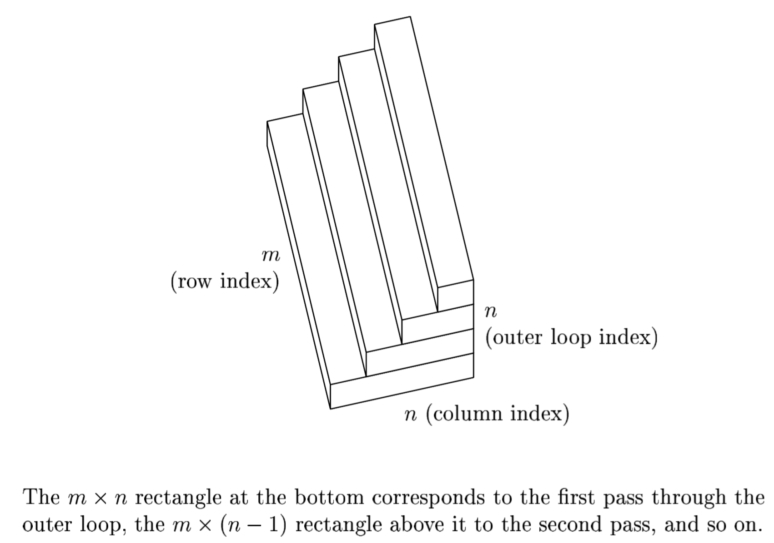
Repeat After Me...
There is no magic shortcut for asymptotic analysis problems (well… usually)
Runtime analysis often requires careful thought.
CS70 and especially CS170 will cover this in much more detail.
This is not a math class, though we’ll expect you to know these:
1^{k}+2^{k}+3^{k}+ … + Q^{k} (k >=0) = Θ(Q^{k+1})
k⁰+k¹+k²+ … + k^{Q} (k > 1) = Θ(k^{Q})
Strategies:
Find exact sum.
Write out examples.
Draw pictures.
QR decomposition runtime, from “Numerical Linear Algebra” by Trefethen.

Slide 32
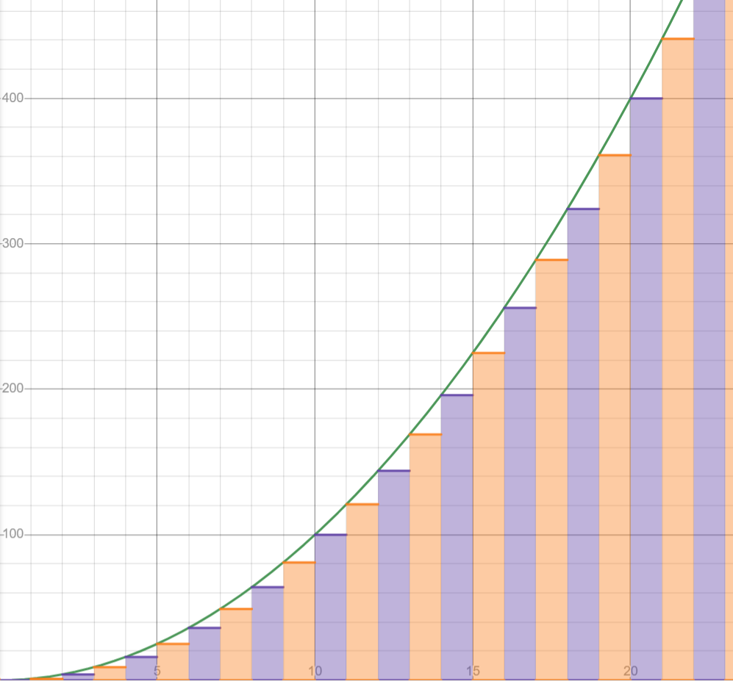
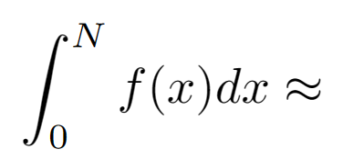
Generalizing the two cases you need to know (Out of Scope)
1^{k}+2^{k}+3^{k}+ … + Q^{k} (k >=0) = Θ(Q^{k+1})
k⁰+k¹+k²+ … + k^{Q} (k > 1) = Θ(k^{Q})
f(0)+f(1)+f(2)+...+f(N) (f continuous)

Slide 33
Generalizing the two cases you need to know (Out of Scope)
1^{k}+2^{k}+3^{k}+ … + Q^{k} (k >=0) = Θ(Q^{k+1})
k⁰+k¹+k²+ … + k^{Q} (k > 1) = Θ(k^{Q})
f(0)+f(1)+f(2)+...+f(N) = Θ(integral of f(x) from 0 to N)
Some shortcuts exist
But they tend to be limited in scope

Slide 34
Amortized Analysis
Nested For Loops
There is No Magic Shortcut for Asymptotic Analysis
Amortized Analysis
Recursive Analysis
Binary Search (Intuitive)
Binary Search (Exact) (Bonus Video)
Mergesort
Lecture 15, CS61B, Spring 2024

Slide 35
Surely no function does this, right?
Let's play with this function a bit
public static void printParty(int n) {
for (int i = 1; i <= n; i = i * 2) {
//i units of work
}
}

Slide 36
Surely no function does this, right?
Add Θ(N) work: Total runtime is still Θ(N)
public static void printParty(int n) {
for (int i = 1; i <= n; i = i * 2) {
//i units of work
}
for (int i = 1; i <= n; i++) {
//1 unit of work
}
}

Slide 37
Surely no function does this, right?
Combine the for loops. No asymptotic change in work done
public static void printParty(int n) {
for (int i = 1; i <= n; i++) {
//1 unit of work
if(i is a power of 2) {
//i units of work
}
}
}

Slide 38
Surely no function does this, right?
Put things in separate functions. Changes an O(1) thing to more O(1) things, so no runtime difference.
public static void printParty(int n) {
for (int i = 1; i <= n; i++) {
foo();
} }
public static void foo() {
if(i is a power of 2) {
bar(i);
}
// 1 unit of work
}
public static void bar(i) {
//i units of work
}

Slide 39
Surely no function does this, right?
Rename functions and define what we do in the commented code. No change in runtime
public void addMany(int n) {
for (int i = 0; i < n; i++) {
addLast(1);
} }
public void addLast(int value) {
if(this.length == arr.length) {
resize(this.length * 2);
} //Happens every time length is 2^{k}
//addLast code takes 1 unit of work
}
public void resize(int i) {
//resizing takes i units of work
}

Slide 40
Why geometric resizing is faster
When we discussed ArrayLists, we handwaved why geometric resizing is better than linear resizing. Now that we know asymptotics, we can finally prove this.
public void addLast(int x) {
if (size == items.length) {
resize(size + RFACTOR);
}
items[size] = x;
size += 1;
}
After N addLasts, runtime is Θ(N²)
public void addLast(int x) {
if (size == items.length) {
resize(size * RFACTOR);
}
items[size] = x;
size += 1;
}
After N addLasts,
runtime is Θ(N)

Slide 41
Why geometric resizing is faster
Even though the worst-case resize is still Θ(N), they happen so infrequently with geometric resizing that we get Θ(1) runtime on average regardless of how we order List operations.
public void addLast(int x) {
if (size == items.length) {
resize(size + RFACTOR);
}
items[size] = x;
size += 1;
}
Each addLast takes on average Θ(N) time
public void addLast(int x) {
if (size == items.length) {
resize(size * RFACTOR);
}
items[size] = x;
size += 1;
}
Each addLast takes on average Θ(1) time

Slide 42
Amortized Runtime
This is known as Amortized Runtime
Any single operation may take longer, but if we use it over many operations, we're guaranteed to have a better average performance
So amortized runtime gives a better estimate of how much time it takes to use something in practice
Disjoint sets also used amortized runtime; WQU with path compression still has Θ(log(n)) runtime in the worst case, but Θ(α(n)) amortized runtime.
public void addLast(int x) {
if (size == items.length) {
resize(size * RFACTOR);
}
items[size] = x;
size += 1;
}
addLast is Θ(1) amortized

Slide 43
Recursive Analysis
Nested For Loops
There is No Magic Shortcut for Asymptotic Analysis
Amortized Analysis
Recursive Analysis
Binary Search (Intuitive)
Binary Search (Exact) (Bonus Video)
Mergesort
Lecture 15, CS61B, Spring 2024

Slide 44
Recursion, Approach 1: Intuitive [no yellkey]
Find a simple f(N) such that the runtime R(N) ∈ Θ(f(N)).
public static int f3(int n) {
if (n <= 1)
return 1;
return f3(n-1) + f3(n-1);
}
Using your intuition, give the order of growth of the runtime of this code as a function of N?
1
log N
N
N²
2^{N}
4
3
3
2
2
2
2
1
1
1
1
1
1
1
1

Slide 45
Recursion, Approach 1: Intuitive
Find a simple f(N) such that the runtime R(N) ∈ Θ(f(N)).
public static int f3(int n) {
if (n <= 1)
return 1;
return f3(n-1) + f3(n-1);
}
2^{N}: Every time we increase N by 1, we double the work!
Using your intuition, give the order of growth of the runtime of this code as a function of N?
1
log N
N
N²
2^{N}
5
4
4
3
3
3
3
2
2
2
2
2
2
2
2
1
1
1
1
1
1
1
1
1
1
1
1
1
1
1
1

Slide 46
Recursion, Approach 2: Exact Counting
Find a simple f(N) such that the runtime R(N) ∈ Θ(f(N)).
public static int f3(int n) {
if (n <= 1)
return 1;
return f3(n-1) + f3(n-1);
}
Another approach: Count number of calls to f3, given by C(N).
Each function call does a constant amount of work (not counting recursive calls), so C(N) ∈ Θ(R(N))
C(1) = 1
C(2) = 1 + 2
C(3) = 1 + 2 + 4
4
3
3
2
2
2
2
1
1
1
1
1
1
1
1

Slide 47
Recursion, Approach 2: Exact Counting: http://yellkey.com/happy
Find a simple f(N) such that the runtime R(N) ∈ Θ(f(N)).
public static int f3(int n) {
if (n <= 1)
return 1;
return f3(n-1) + f3(n-1);
}
Another approach: Count number of calls to f3, given by C(N).
C(3) = 1 + 2 + 4
C(N) = 1 + 2 + 4 + … + ???
What is the final term of the sum?
N
2^{N}
2^{N}-1
4
D. 2^{N-1}
E. 2^{N-1}-1
3
3
2
2
2
2
1
1
1
1
1
1
1
1

Slide 48
Recursion, Approach 2: Exact Counting
Find a simple f(N) such that the runtime R(N) ∈ Θ(f(N)).
public static int f3(int n) {
if (n <= 1)
return 1;
return f3(n-1) + f3(n-1);
}
Another approach: Count number of calls to f3, given by C(N).
C(3) = 1 + 2 + 4
C(N) = 1 + 2 + 4 + … + ???
What is the final term of the sum?
4
3
3
D. 2^{N-1}
2
2
2
2
1
1
1
1
1
1
1
1

Slide 49
Recursion, Approach 2: Exact Counting
Find a simple f(N) such that the runtime R(N) ∈ Θ(f(N)).
public static int f3(int n) {
if (n <= 1)
return 1;
return f3(n-1) + f3(n-1);
}
Another approach: Count number of calls to f3, given by C(N).
C(N) = 1 + 2 + 4 + … + 2^{N-1}
Give a simple expression for C(N).
4
3
3
2
2
2
2
1
1
1
1
1
1
1
1

Slide 50
Recursion, Approach 2: Exact Counting
Find a simple f(N) such that the runtime R(N) ∈ Θ(f(N)).
public static int f3(int n) {
if (n <= 1)
return 1;
return f3(n-1) + f3(n-1);
}
Another approach: Count number of calls to f3, given by C(N).
C(N) = 1 + 2 + 4 + … + 2^{N-1}
Give a simple expression for C(N).
C(N) = 2(2^{N-1}) - 1
C(N) = 2^{N}-1
4
3
3
2
2
2
2
1
1
1
1
1
1
1
1

Slide 51
Recursion, Approach 2: Exact Counting
Find a simple f(N) such that the runtime R(N) ∈ Θ(f(N)).
public static int f3(int n) {
if (n <= 1)
return 1;
return f3(n-1) + f3(n-1);
}
Another approach: Count number of calls to f3, given by C(N).
C(N) = 1 + 2 + 4 + … + 2^{N-1}
Solving, we get C(N) = 2^{N} - 1
Since work during each call is constant:
R(N) = Θ(2^{N})
4
3
3
2
2
2
2
1
1
1
1
1
1
1
1

Slide 52
Recursion, A minor change
Find a simple f(N) such that the runtime R(N) ∈ Θ(f(N)).
public static int fib(int n) {
if (n <= 1)
return 1;
return fib(n-1) + fib(n-2);
}
What happens if we make this tiny change?
C(0) = 1
C(1) = 1
C(2) = 1+1+1
C(3) = 1+1+2+1
?????
Give a simple expression for C(N).
4
3
2
2
1
1
0
1
0

Slide 53
Recursion, A minor change (Out of Scope)
Find a simple f(N) such that the runtime R(N) ∈ Θ(f(N)).
public static int fib(int n) {
if (n <= 1)
return 1;
return fib(n-1) + fib(n-2);
}
For this one, we'll have to be a bit more creative:
fib(n) returns the nth Fibonacci number F_{n}
In the tree on the right, there are F_{n} yellow nodes
Why? Each leaf adds 1 to the final sum
In the tree on the right, there are F_{n}-1 green nodes
Why? To sum k 1s, we do k-1 +s
C(N) = # yellow + # green = 2(F_{N})-1 = Θ(F_{N})
4
3
2
2
1
1
0
1
0

Slide 54
Recursion, A minor change (Out of Scope)
Find a simple f(N) such that the runtime R(N) ∈ Θ(f(N)).
public static int fib(int n) {
if (n <= 1)
return 1;
return fib(n-1) + fib(n-2);
}
C(N) = # yellow + # green = 2(F_{N})-1 = Θ(F_{N})
If you do enough math, you find that F_{N}∈ Θ(φ^{N})
Where φ = (1+sqrt(5))/2 ≈ 1.618
Each function call does 1 unit of work
So R(N) = Θ(1.618^{N})
In conclusion: There is no Magic Shortcut for
Asymptotic Analysis
4
3
2
2
1
1
0
1
0

Slide 55
Recursion, Approach 3: Recurrence Relations (Out of Scope for 61B)
Find a simple f(N) such that the runtime R(N) ∈ Θ(f(N)).
public static int f3(int n) {
if (n <= 1)
return 1;
return f3(n-1) + f3(n-1)
}
Third approach: Count number of calls to f3, given by a “recurrence relation” for C(N).
C(1) = 1
C(N) =
2C(N-1) + 1
4
3
3
2
2
2
2
1
1
1
1
1
1
1
1

Slide 56
Recursion, Approach 3: Recurrence Relations (Out of Scope for 61B)
Find a simple f(N) such that the runtime R(N) ∈ Θ(f(N)).
public static int f3(int n) {
if (n <= 1)
return 1;
return f3(n-1) + f3(n-1)
}
Third approach: Count number of calls to f3, given by a “recurrence relation” for C(N).
C(1) = 1
C(N) =
2C(N-1) + 1
4
3
3
More technical to solve. Won’t do this in our course. See next slide for solution.
2
2
2
2
1
1
1
1
1
1
1
1

Slide 57
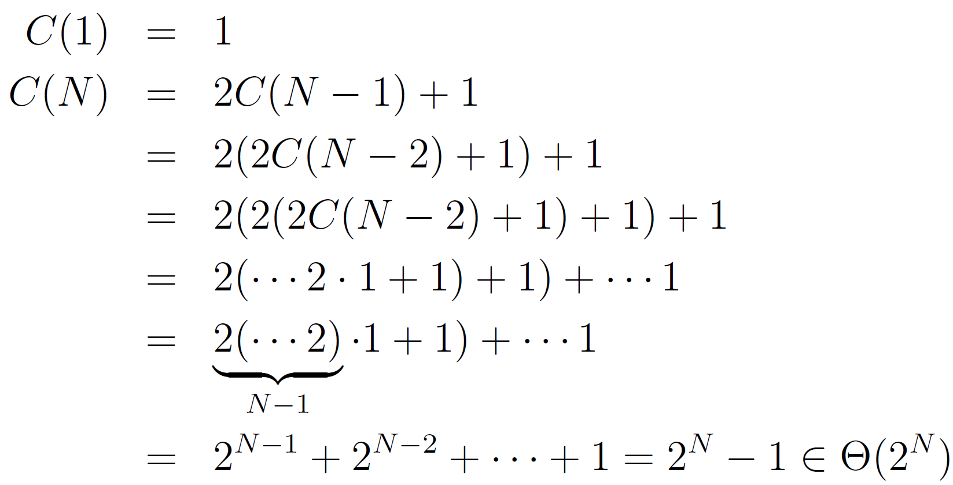
Recursion, Approach 3: Recurrence Relations (Out of Scope for 61B)
Find a simple f(N) such that the runtime R(N) ∈ Θ(f(N)).
public static int f3(int n) {
if (n <= 1)
return 1;
return f3(n-1) + f3(n-1)
}
This approach not covered in class. Provided for those of you who want to see a recurrence relation solution.
Third approach: Count number of calls to f3, given by a “recurrence relation” for C(N).
4
3
3
2
2
2
2
1
1
1
1
1
1
1
1

Slide 58
Binary Search (Intuitive)
Nested For Loops
There is No Magic Shortcut for Asymptotic Analysis
Amortized Analysis
Recursive Analysis
Binary Search (Intuitive)
Binary Search (Exact) (Bonus Video)
Mergesort
Lecture 15, CS61B, Spring 2024

Slide 59
Binary Search (demo: https://goo.gl/3VvJNw)
Trivial to implement?
Idea published in 1946.
First correct implementation in 1962.
Bug in Java’s binary search discovered in 2006.
See Jon Bentley’s book Programming Pearls.
See http://goo.gl/gQI0FN
static int binarySearch(String[] sorted, String x, int lo, int hi)
if (lo > hi) return -1;
int m = (lo + hi) / 2;
int cmp = x.compareTo(sorted[m]);
if (cmp < 0) return binarySearch(sorted, x, lo, m - 1);
else if (cmp > 0) return binarySearch(sorted, x, m + 1, hi);
else return m;
}
Notes:
http://www.cs.princeton.edu/courses/archive/fall14/cos226/demo/14DemoBinarySearch.pdf

Slide 60
Binary Search (Intuitive): http://yellkey.com/beyond
static int binarySearch(String[] sorted, String x, int lo, int hi)
if (lo > hi) return -1;
int m = (lo + hi) / 2;
int cmp = x.compareTo(sorted[m]);
if (cmp < 0) return binarySearch(sorted, x, lo, m - 1);
else if (cmp > 0) return binarySearch(sorted, x, m + 1, hi);
else return m;
}
Goal: Find runtime in terms of N = hi - lo + 1 [i.e. # of items being considered]
Intuitively, what is the order of growth of the worst case runtime?
1
log₂ N
N
N log₂ N
2^{N}
Notes:
http://www.cs.princeton.edu/courses/archive/fall14/cos226/demo/14DemoBinarySearch.pdf

Slide 61
Binary Search (Intuitive)
static int binarySearch(String[] sorted, String x, int lo, int hi)
if (lo > hi) return -1;
int m = (lo + hi) / 2;
int cmp = x.compareTo(sorted[m]);
if (cmp < 0) return binarySearch(sorted, x, lo, m - 1);
else if (cmp > 0) return binarySearch(sorted, x, m + 1, hi);
else return m;
}
Goal: Find runtime in terms of N = hi - lo + 1 [i.e. # of items being considered]
Intuitively, what is the order of growth of the worst case runtime?
B. log₂N
Why? Problem size halves over and over until it gets down to 1.
If C is number of calls to binarySearch, solve for 1 = N/2^{C} → C = log₂(N)
N
≈N/2
≈N/4
≈N/8
Notes:
http://www.cs.princeton.edu/courses/archive/fall14/cos226/demo/14DemoBinarySearch.pdf

Slide 62
Log Time Is Really Terribly Fast
In practice, logarithmic time algorithms have almost constant runtimes.
Even for incredibly huge datasets, practically equivalent to constant time.
N | log₂ N | Typical runtime (seconds)
100 | 6.6 | 1 nanosecond
100,000 | 16.6 | 2.5 nanoseconds
100,000,000 | 26.5 | 4 nanoseconds
100,000,000,000 | 36.5 | 5.5 nanoseconds
100,000,000,000,000 | 46.5 | 7 nanoseconds

Slide 63
Binary Search Exact (Bonus)
Nested For Loops
There is No Magic Shortcut for Asymptotic Analysis
Amortized Analysis
Recursive Analysis
Binary Search Intuitive
Binary Search Exact (Bonus)
Mergesort
Lecture 15, CS61B, Spring 2024

Slide 64
This section is available as a pre-recorded video.
It's not ”out of scope” since it’s just another example problem using the same techniques used throughout the lecture.

Slide 65
Binary Search (Exact Count): Not a Live Video (no yellkey)
static int binarySearch(String[] sorted, String x, int lo, int hi)
if (lo > hi) return -1;
int m = (lo + hi) / 2;
int cmp = x.compareTo(sorted[m]);
if (cmp < 0) return binarySearch(sorted, x, lo, m - 1);
else if (cmp > 0) return binarySearch(sorted, x, m + 1, hi);
else return m;
}
Goal: Find worst case runtime in terms of N = hi - lo + 1 [i.e. # of items]
Each call does constant work (w/o recursive calls)
What is C(6), number of total calls for N = 6?
6 D. 2
3 E. 1
log₂(6)=2.568
N=6
Notes:
http://www.cs.princeton.edu/courses/archive/fall14/cos226/demo/14DemoBinarySearch.pdf

Slide 66
Binary Search (Exact Count)
static int binarySearch(String[] sorted, String x, int lo, int hi)
if (lo > hi) return -1;
int m = (lo + hi) / 2;
int cmp = x.compareTo(sorted[m]);
if (cmp < 0) return binarySearch(sorted, x, lo, m - 1);
else if (cmp > 0) return binarySearch(sorted, x, m + 1, hi);
else return m;
}
Goal: Find worst case runtime in terms of N = hi - lo + 1 [i.e. # of items]
Each call does constant work (w/o recursive calls)
What is C(6), number of total calls for N = 6?
B. 3
Three total calls, where N = 6, N = 3, and N = 1.
N=6
3 calls
N=3
N=1
Notes:
http://www.cs.princeton.edu/courses/archive/fall14/cos226/demo/14DemoBinarySearch.pdf

Slide 67
Binary Search (Exact Count)
static int binarySearch(String[] sorted, String x, int lo, int hi)
if (lo > hi) return -1;
int m = (lo + hi) / 2;
int cmp = x.compareTo(sorted[m]);
if (cmp < 0) return binarySearch(sorted, x, lo, m - 1);
else if (cmp > 0) return binarySearch(sorted, x, m + 1, hi);
else return m;
}
Goal: Find worst case runtime in terms of N = hi - lo + 1 [i.e. # of items]
Number of binarySearch calls.
N
1 | 2 | 3 | 4 | 5 | 6 | 7 | 8 | 9 | 10 | 11 | 12 | 13
C(N)
1 |  |  |  |  | 3
N=1
Notes:
http://www.cs.princeton.edu/courses/archive/fall14/cos226/demo/14DemoBinarySearch.pdf

Slide 68
Binary Search (Exact Count)
static int binarySearch(String[] sorted, String x, int lo, int hi)
if (lo > hi) return -1;
int m = (lo + hi) / 2;
int cmp = x.compareTo(sorted[m]);
if (cmp < 0) return binarySearch(sorted, x, lo, m - 1);
else if (cmp > 0) return binarySearch(sorted, x, m + 1, hi);
else return m;
}
Goal: Find worst case runtime in terms of N = hi - lo + 1 [i.e. # of items]
Number of binarySearch calls.
N
1 | 2 | 3 | 4 | 5 | 6 | 7 | 8 | 9 | 10 | 11 | 12 | 13
C(N)
1 | 2 | 2 |  |  | 3
N=2
N=3
N=1
Notes:
http://www.cs.princeton.edu/courses/archive/fall14/cos226/demo/14DemoBinarySearch.pdf

Slide 69
Binary Search (Exact Count)
static int binarySearch(String[] sorted, String x, int lo, int hi)
if (lo > hi) return -1;
int m = (lo + hi) / 2;
int cmp = x.compareTo(sorted[m]);
if (cmp < 0) return binarySearch(sorted, x, lo, m - 1);
else if (cmp > 0) return binarySearch(sorted, x, m + 1, hi);
else return m;
}
Goal: Find worst case runtime in terms of N = hi - lo + 1 [i.e. # of items]
Number of binarySearch calls.
4
5
6
7
N
1 | 2 | 3 | 4 | 5 | 6 | 7 | 8 | 9 | 10 | 11 | 12 | 13
C(N)
1 | 2 | 2 | 3 | 3 | 3 | 3
N=2
N=3
N=1
Notes:
http://www.cs.princeton.edu/courses/archive/fall14/cos226/demo/14DemoBinarySearch.pdf

Slide 70
Binary Search (Exact Count)
static int binarySearch(String[] sorted, String x, int lo, int hi)
if (lo > hi) return -1;
int m = (lo + hi) / 2;
int cmp = x.compareTo(sorted[m]);
if (cmp < 0) return binarySearch(sorted, x, lo, m - 1);
else if (cmp > 0) return binarySearch(sorted, x, m + 1, hi);
else return m;
}
Goal: Find worst case runtime in terms of N = hi - lo + 1 [i.e. # of items]
Number of binarySearch calls.
8
9
...
4
5
6
7
N
1 | 2 | 3 | 4 | 5 | 6 | 7 | 8 | 9 | 10 | 11 | 12 | 13
C(N)
1 | 2 | 2 | 3 | 3 | 3 | 3 | 4 | 4 | 4 | 4 | 4 | 4
N=2
N=3
N=1
Notes:
http://www.cs.princeton.edu/courses/archive/fall14/cos226/demo/14DemoBinarySearch.pdf

Slide 71
Binary Search (Exact Count)
static int binarySearch(String[] sorted, String x, int lo, int hi)
if (lo > hi) return -1;
int m = (lo + hi) / 2;
int cmp = x.compareTo(sorted[m]);
if (cmp < 0) return binarySearch(sorted, x, lo, m - 1);
else if (cmp > 0) return binarySearch(sorted, x, m + 1, hi);
else return m;
}
Goal: Find worst case runtime in terms of N = hi - lo + 1 [i.e. # of items]
Number of binarySearch calls.
8
9
...
4
5
6
7
N
1 | 2 | 3 | 4 | 5 | 6 | 7 | 8 | 9 | 10 | 11 | 12 | 13
C(N)
1 | 2 | 2 | 3 | 3 | 3 | 3 | 4 | 4 | 4 | 4 | 4 | 4
N=2
N=3
C(N) = ⌊log₂(N)⌋+1
N=1
Notes:
http://www.cs.princeton.edu/courses/archive/fall14/cos226/demo/14DemoBinarySearch.pdf

Slide 72
Binary Search (Exact Count)
static int binarySearch(String[] sorted, String x, int lo, int hi)
if (lo > hi) return -1;
int m = (lo + hi) / 2;
int cmp = x.compareTo(sorted[m]);
if (cmp < 0) return binarySearch(sorted, x, lo, m - 1);
else if (cmp > 0) return binarySearch(sorted, x, m + 1, hi);
else return m;
}
Goal: Find worst case runtime in terms of N = hi - lo + 1 [i.e. # of items]
Number of binarySearch calls.
C(N) = ⌊log₂(N)⌋+1
Since each call takes constant time, R(N) = Θ(⌊log₂(N)⌋)
This f(N) is way too complicated. Let’s simplify.
8
9
...
4
5
6
7
N=2
N=3
N=1
Notes:
http://www.cs.princeton.edu/courses/archive/fall14/cos226/demo/14DemoBinarySearch.pdf

Slide 73
Handy Big Theta Properties
Goal: Simplify Θ(⌊log₂(N)⌋)
Three handy properties to help us simplify:
⌊f(N)⌋=Θ(f(N)) [the floor of f has same order of growth as f]
⌈f(N)⌉=Θ(f(N)) [the ceiling of f has same order of growth as f]
log_{P}(N) = Θ(log_{Q}(N)) [logarithm base does not affect order of growth]
⌊log₂(N)⌋ = Θ(log N)
For proof:
See online textbook exercises.
Since base is irrelevant, we omit from our big theta expression. We also omit the parenthesis around N for aesthetic reasons.
Notes:
http://www.cs.princeton.edu/courses/archive/fall14/cos226/demo/14DemoBinarySearch.pdf

Slide 74
Binary Search (Exact Count)
static int binarySearch(String[] sorted, String x, int lo, int hi)
if (lo > hi) return -1;
int m = (lo + hi) / 2;
int cmp = x.compareTo(sorted[m]);
if (cmp < 0) return binarySearch(sorted, x, lo, m - 1);
else if (cmp > 0) return binarySearch(sorted, x, m + 1, hi);
else return m;
}
Goal: Find worst case runtime in terms of N = hi - lo + 1 [i.e. # of items]
Number of binarySearch calls.
C(N) = ⌊log₂(N)⌋+1 = Θ(log N)
Since each call takes constant time, R(N) = Θ(log N)
… and we’re done!
8
9
...
4
5
6
7
N=2
N=3
N=1
Notes:
http://www.cs.princeton.edu/courses/archive/fall14/cos226/demo/14DemoBinarySearch.pdf

Slide 75
Binary Search (using Recurrence Relations)
static int binarySearch(String[] sorted, String x, int lo, int hi)
if (lo > hi) return -1;
int m = (lo + hi) / 2;
int cmp = x.compareTo(sorted[m]);
if (cmp < 0) return binarySearch(sorted, x, lo, m - 1);
else if (cmp > 0) return binarySearch(sorted, x, m + 1, hi);
else return m;
}
Approach: Measure number of string comparisons for N = hi - lo + 1.
C(0) = 0
C(1) = 1
C(N) = 1 + C((N-1)/2)
Can show that C(N) = Θ(log N). Beyond scope of class, so won’t solve in slides.
Notes:
http://www.cs.princeton.edu/courses/archive/fall14/cos226/demo/14DemoBinarySearch.pdf

Slide 76
Mergesort
Nested For Loops
There is No Magic Shortcut for Asymptotic Analysis
Amortized Analysis
Recursive Analysis
Binary Search Intuitive
Binary Search Exact (Bonus)
Mergesort
Lecture 15, CS61B, Spring 2024

Slide 77
Sorting
Along with matrix multiplication, sorting is one of the problems that pops up most often in asymptotic analysis.
Given a list of Comparables, return them in sorted order
Assumes the comparison method is transitive, reflexive, symmetric (see Lecture 12), and runs in Θ(1) time.
x = List.of({“he”, “is”, “the”, “agoyatis”, “of”, “mr.”, “conchis”})
public static List<Comparable> sort(List<Comparable> x)
x = {“agoyatis”, “conchis”, “he”, “is”, “mr.”, “of”, “the”}

Slide 78
Mergesort Pseudocode
Mergesort is a recursive way to sort a list:
Split the list into two parts
Sort the two lists individually
Merge the two lists together
static List<Comparable> sort(List<Comparable> x)
List<Comparable> firsthalf = sort(x.sublist(0, x.size()/2));
List<Comparable> secondhalf = sort(x.sublist(x.size()/2, x.size()));
return merge(firsthalf, secondhalf);
}

Slide 79
The Merge Operation
Given two sorted arrays, the merge operation combines them into a single sorted array by successively copying the smallest item from the two arrays into a target array.
Merging Demo (Link)

Slide 80
Merge Runtime: http://yellkey.com/show
2
3
6
10
11
4
5
7
8
2
3
4
5
6
7
8
10
11
How does the runtime of merge grow with N, the total number of items?
Θ(1) C. Θ(N)
Θ(log N) D. Θ(N²)

Slide 81
Merge Runtime
2
3
6
10
11
4
5
7
8
2
3
4
5
6
7
8
10
11
How does the runtime of merge grow with N, the total number of items?
C. Θ(N). Why? Θ(1) time per element in the merged list, and the merged list has exactly N items

Slide 82
Determining Mergesort Runtime
static List<Comparable> sort(List<Comparable> x)
List<Comparable> firsthalf = sort(x.sublist(0, x.size()/2));
List<Comparable> secondhalf = sort(x.sublist(x.size()/2, x.size()));
return merge(firsthalf, secondhalf);
}
Since we don't care about the list itself, let's simplify our code a bit
Our runtime should be in terms of x.size(), so let's let int n = x.size()
merge takes Θ(n) time, so let's replace that with "n units of work"

Slide 83
Determining Mergesort Runtime
static void sortRuntime(int n)
sortRuntime(n/2);
sortRuntime(n/2);
//n units of work
}
Since we don't care about the list itself, let's simplify our code a bit
Our runtime should be in terms of x.size(), so let's let int n = x.size()
merge takes Θ(n) time, so let's replace that with "n units of work"

Slide 84
Example 5: Mergesort Order of Growth, yellkey.com/consider
static void sortRuntime(int n)
sortRuntime(n/2);
sortRuntime(n/2);
//n units of work
}
For an array of size N, what is the worst case runtime of Mergesort?
Θ(1)
Θ(log N)
Θ(N)
Θ(N log N)
Θ(N²)
N
k
N/2
N/2
N/4
N/4
N/4
N/4
….
N/8
N/8
N/8
N/8
….

Slide 85
Example 5: Mergesort Order of Growth
Mergesort has worst case runtime = Θ(N log N).
Every level has N units of work.
Top level takes N units of work.
Next level takes N/2 + N/2 = N units of work.
One more level down: N/4 + N/4 + N/4 + N/4 = N.
Thus, total runtime is Nk, where k is the number of levels.
How many levels? Goes until we get to size 1.
k = log₂(N).
Overall runtime is Θ(N log N).
Exact count explanation is tedious.
Omitted here. See textbook exercises.
N
k
N/2
N/2
N/4
N/4
N/4
N/4
….
N/8
N/8
N/8
N/8
….

Slide 86
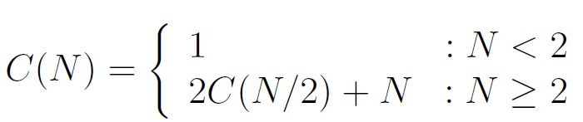
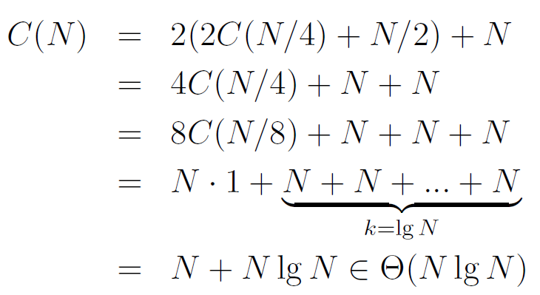
Mergesort using Recurrence Relations (Extra)
C(N): Number of calls to mergesort + number of array writes.
Only works for N=2^{k}. Can be generalized at the expense of some tedium by separately finding Big O and Big Omega bounds (see next lecture).
N
k
N/2
N/2
N/4
N/4
N/4
N/4
….
N/8
N/8
N/8
N/8
….

Slide 87
Using Sorting as a Tool
Recall from Lecture 13 the dup functions, which checked if a sorted array contained any duplicates.
dup1 took Θ(N²) runtime, while dup2 took Θ(N) runtime
What if the input wasn't sorted?
public static boolean dup1(int[] A) {
for (int i = 0; i < A.length; i += 1) {
for (int j = i + 1; j < A.length; j += 1) {
if (A[i] == A[j]) {
return true;
}
}
}
return false;
}
dup2
public static boolean dup2(int[] A) {
for (int i = 0; i < A.length - 1; i += 1) {
if (A[i] == A[i + 1]) {
return true;
}
}
return false;
}
dup1

Slide 88
Using Sorting as a Tool
What if the input wasn't sorted?
dup1 still works normally, but it takes Θ(N²) runtime
dup2 no longer works… Can we fix it?
public static boolean dup1(int[] A) {
for (int i = 0; i < A.length; i += 1) {
for (int j = i + 1; j < A.length; j += 1) {
if (A[i] == A[j]) {
return true;
}
}
}
return false;
}
dup2
public static boolean dup2(int[] A) {
for (int i = 0; i < A.length - 1; i += 1) {
if (A[i] == A[i + 1]) {
return true;
}
}
return false;
}
dup1

Slide 89
Using Sorting as a Tool
What if the input wasn't sorted?
Solution: Sort A first!
What's our new runtime?
Sorting took Θ(N log N) time, the rest of dup2 took Θ(N) time
public static boolean dup1(int[] A) {
for (int i = 0; i < A.length; i += 1) {
for (int j = i + 1; j < A.length; j += 1) {
if (A[i] == A[j]) {
return true;
}
}
}
return false;
}
dup2
public static boolean dup2(int[] A) {
A = A.sort()
for (int i = 0; i < A.length - 1; i += 1) {
if (A[i] == A[i + 1]) {
return true;
}
}
return false;
}
dup1

Slide 90
Using Sorting as a Tool
What if the input wasn't sorted?
dup1 still works normally, but it takes Θ(N²) runtime
If we use sort as a black box, we can modify dup2 so it runs in Θ(N log N) time!
Can we do better? Yes, we can get Θ(N)... once we get to hashing
public static boolean dup1(int[] A) {
for (int i = 0; i < A.length; i += 1) {
for (int j = i + 1; j < A.length; j += 1) {
if (A[i] == A[j]) {
return true;
}
}
}
return false;
}
dup2
public static boolean dup2(int[] A) {
A = A.sort()
for (int i = 0; i < A.length - 1; i += 1) {
if (A[i] == A[i + 1]) {
return true;
}
}
return false;
}
dup1

Slide 91
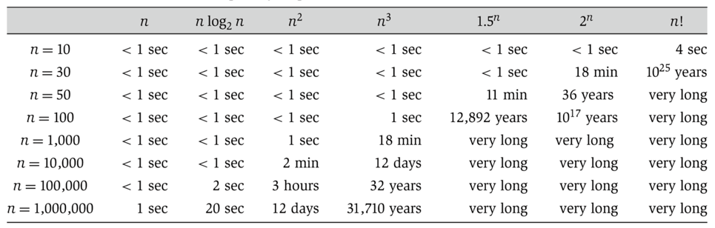

Linear vs. Linearithmic (N log N) vs. Quadratic
N log N is basically as good as N, and is vastly better than N².
For N = 1,000,000, the log N is only 20.
(from Algorithm Design: Tardos, Kleinberg)

Slide 92
Summary
Theoretical analysis of algorithm performance requires careful thought.
There are no magic shortcuts for analyzing code.
In our course, it’s OK to do exact counting or intuitive analysis.
Know how to sum 1^{k}+2^{k}+...+N^{k} and k⁰+k¹+...+k^{N}.
We won’t be writing mathematical proofs in this class.
Many runtime problems you’ll do in this class resemble one of the five problems from today. See textbook, study guide, and discussion for more practice.
This topic has one of the highest skill ceilings of all topics in the course, and is a modern research topic
Different solutions to the same problem, e.g. sorting, may have different runtimes.
N² vs. N log N is an enormous difference.
Going from N log N to N is nice, but not a radical change.
Once you prove runtime for one problem, you may be able to use it in other problems to speed things up!

